Slide 1

Flipkart Shopping
Angular project
By Aarthi S

Slide 2
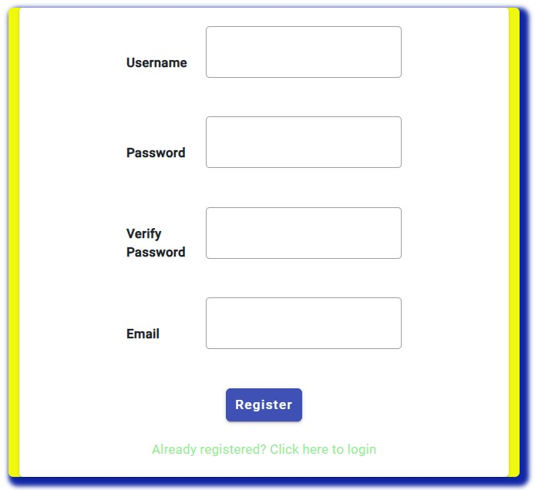
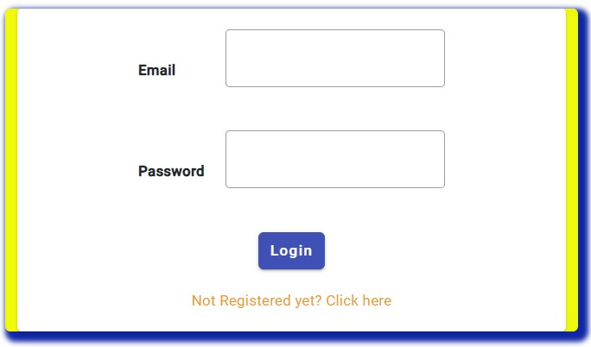
Login Component

Slide 3
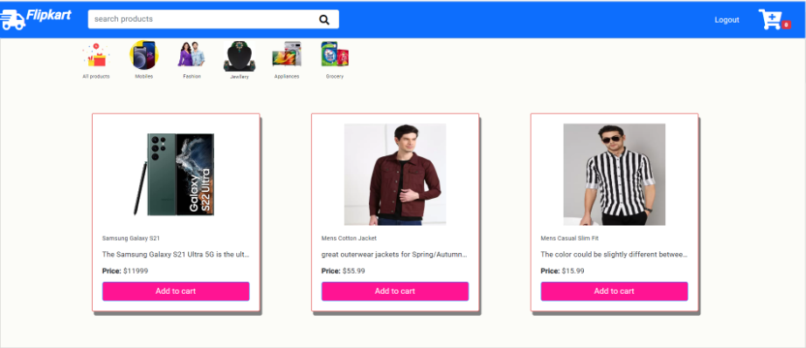
Home Page for user
It consist of all products
Like ……………………………………
Mobiles
Fashion
Jewelry
Appliances
Grocery’s

Slide 4
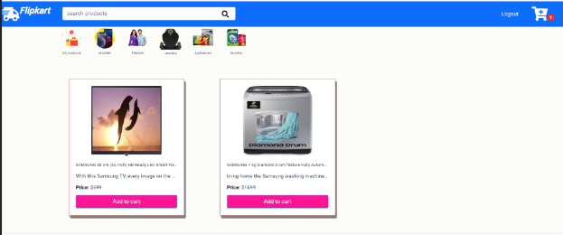
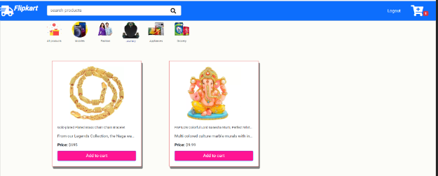
Filter by Products

Slide 5
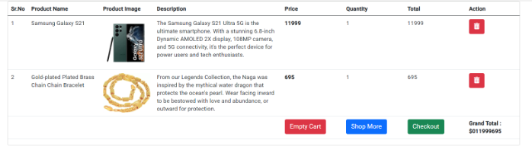
Add to cart
When product added to cart that product contains
1. S.no
2.product name
3.product image
4.description
5.price of product
6.quantity
7.total amount
8. if you want to shop more press shop more option it gets re direct to products page

Slide 6

Thank you

